Slide 1
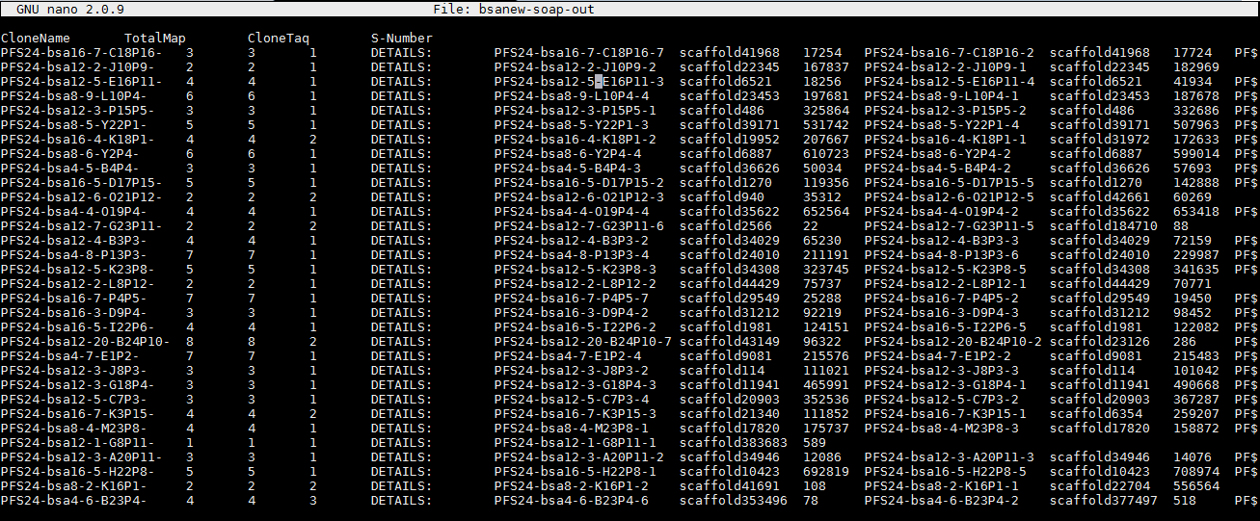
Yuan
BAC SOAP OUTPUT FILE

Slide 2
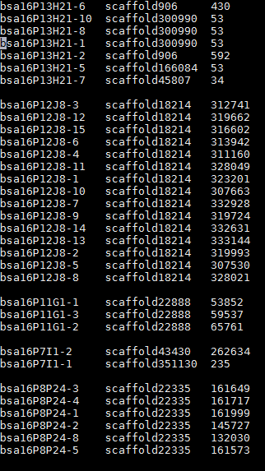
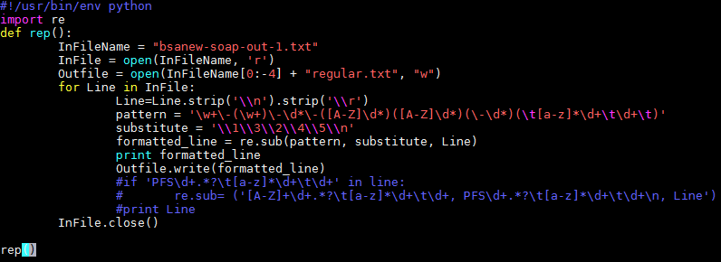
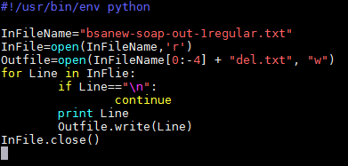
STEP ONE:
delete first five columns and reformat to three columns
Trchniques:
regular expression in jEdit
Python re module

Slide 3
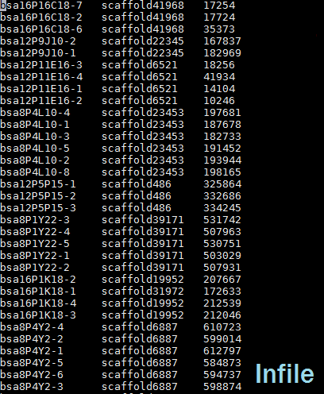
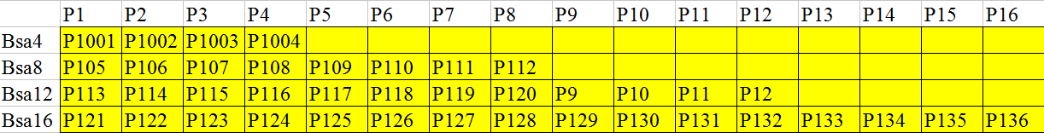
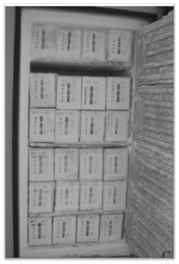
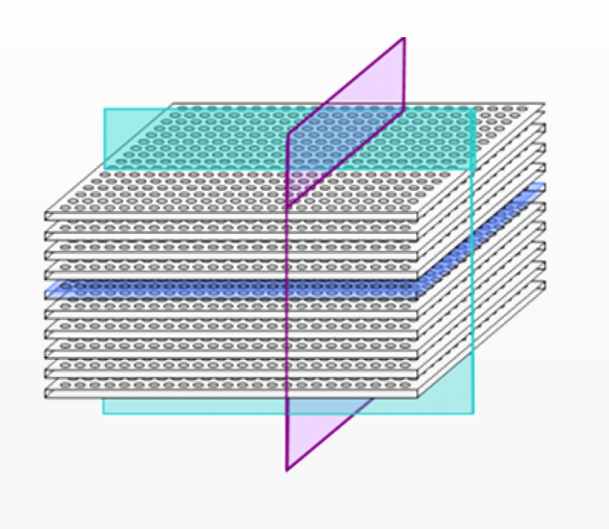
Step two:
decoding

Slide 4
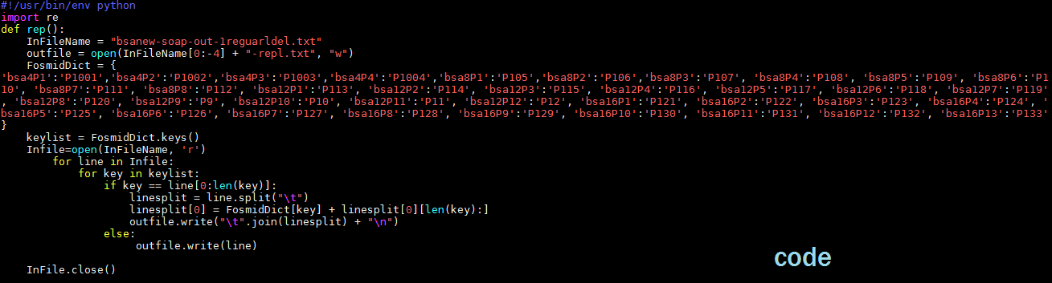
make a dictionary,
bsaNo. + PNo. as the key,
the Pxx as the value.

Slide 5
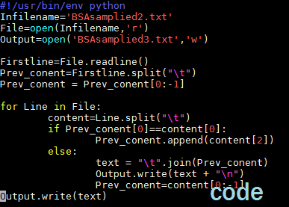
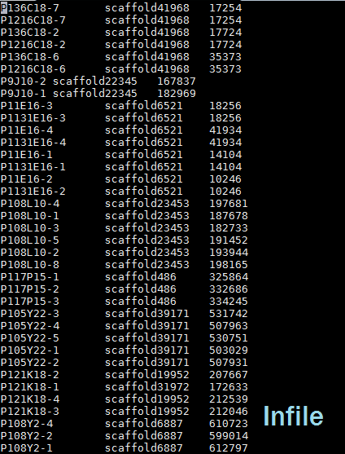
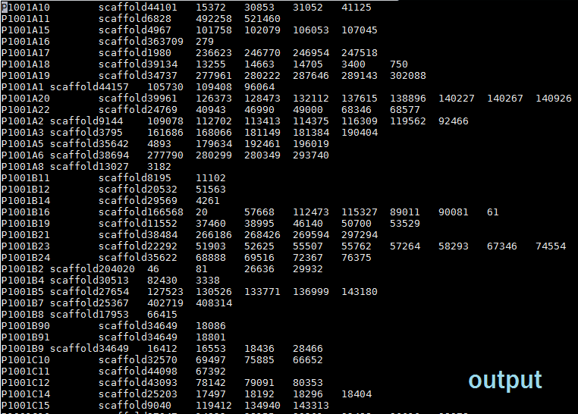
Step three:
combine the same conlny
sort the position No.

Slide 6
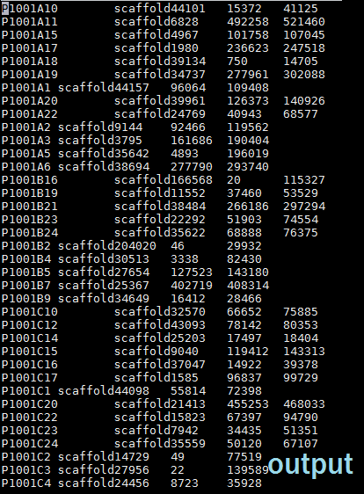
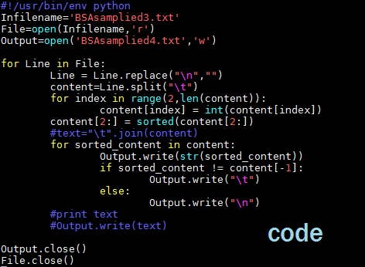
sort the position number and keep the low and large number_regex,jDeit
Search : ^(\w+\s\w+\s\w+).*(\s\w+)$
Replace: $1$2

